Slide 1
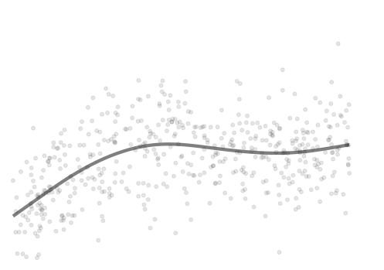




Modeling Adolescent Executive Function Development Across Assessments and Datasets
Brenden Tervo-Clemmens, PhD
University of Minnesota
btervocl@umn.edu
@tervoclemmensb

Slide 2
Outline
Conceptual and methodological context for these questions.
Theories of human neurobehavioral development in adolescence
Non-linear modeling of lifespan trajectories
Foundational methods we have used to construct models across assessments and datasets.
R markdown and interactive examples
Extensions of these methods and looking forward to new directions.

Slide 3
Outline
Conceptual and methodological context for these questions.
Theories of human neurobehavioral development in adolescence
Non-linear modeling of lifespan trajectories
Foundational methods we have used to construct models across assessments and datasets.
R markdown and interactive examples
Extensions of these methods and looking forward to new directions.

Slide 4

Adolescence
Notes:
I view myself as a Developmental neuroscientist.

Slide 5
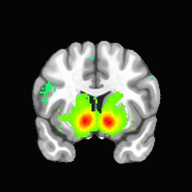
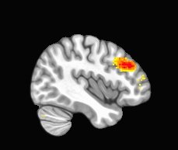
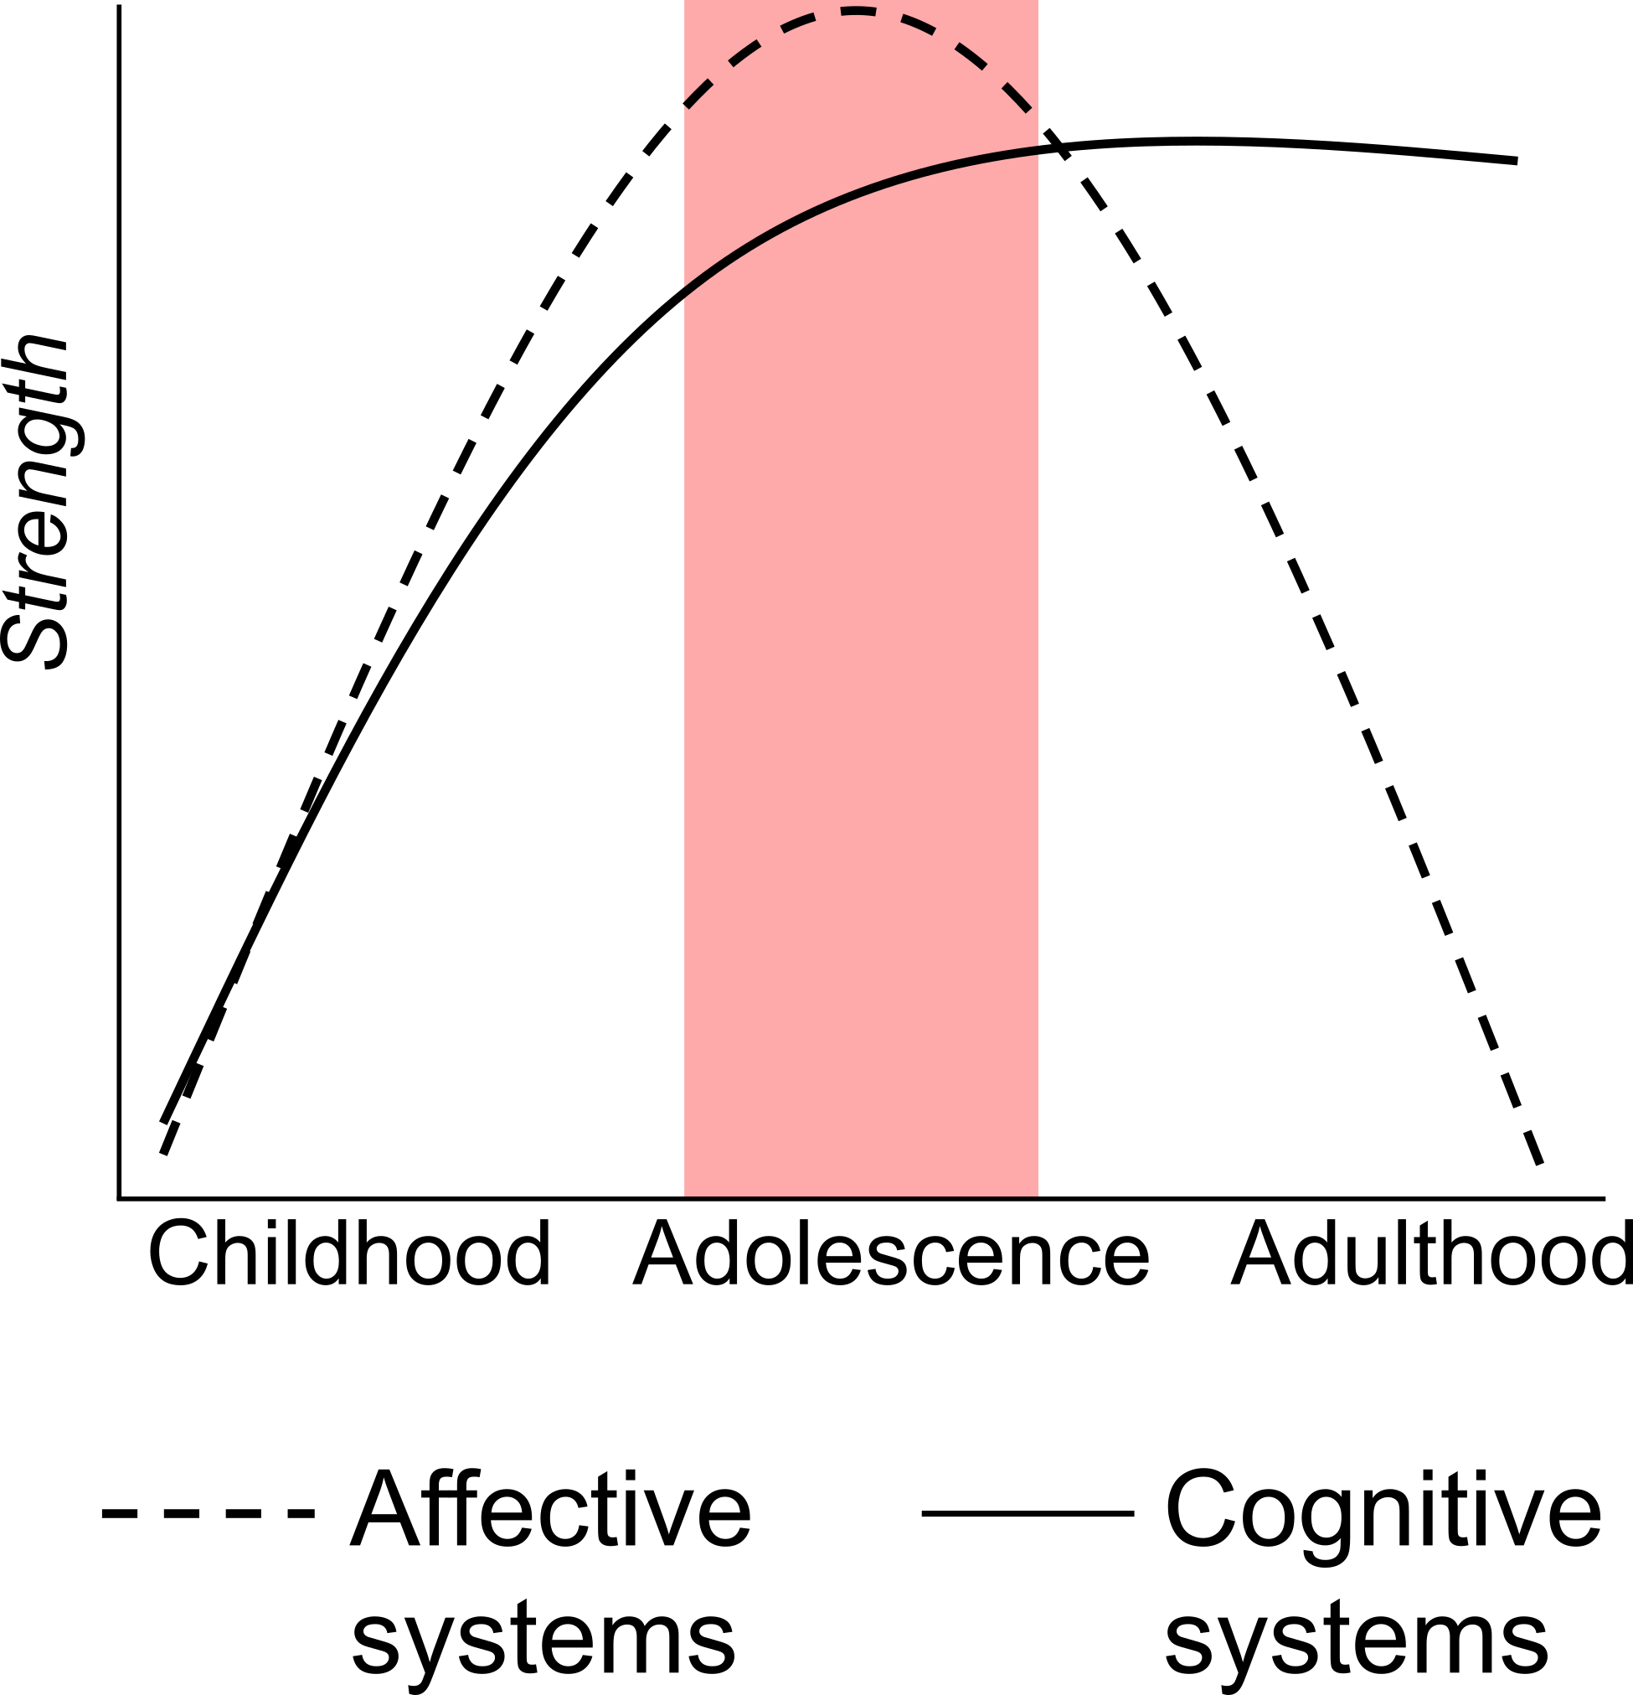
Adolescence
Brain-Behavior
Development
Reward
Cognition
Luna & Wright (2015)
Notes:
And chief among my interest is understanding how deviations from normative brain and behavioral development, gives rise to the mental health and substance use disorders that so often first emerge during adolescence

Slide 6
Adolescence
Brain-Behavior
Development
Reward
Cognition
Mental Health/Substance Use Disorder Onset
Luna & Wright (2015)
Adolescence
Paus et al 2008
Age (years)
Notes:
That is understanding the development of neural, behavioral, and symptom processes of this key period of lifespan of adolescence (highlighted in these figures by the transparent pink area) that is so critical to mental health trajectories.
For example, with the typical age ranges of mental health and substance use disorder diagnostic onsets highlighted in the bottom image.
And one of the key ways I am to consider this is working to conceptualizing relative periods often measured by years as of relative risk for mental health disorders and/or as essential to normative brain-behavior processes. Perhaps by way of analogy we can think of transforming our typical conceptualization of high risk particpants (as we may do in a clinical cohort) to high risk periods of the lifespan.

Slide 7
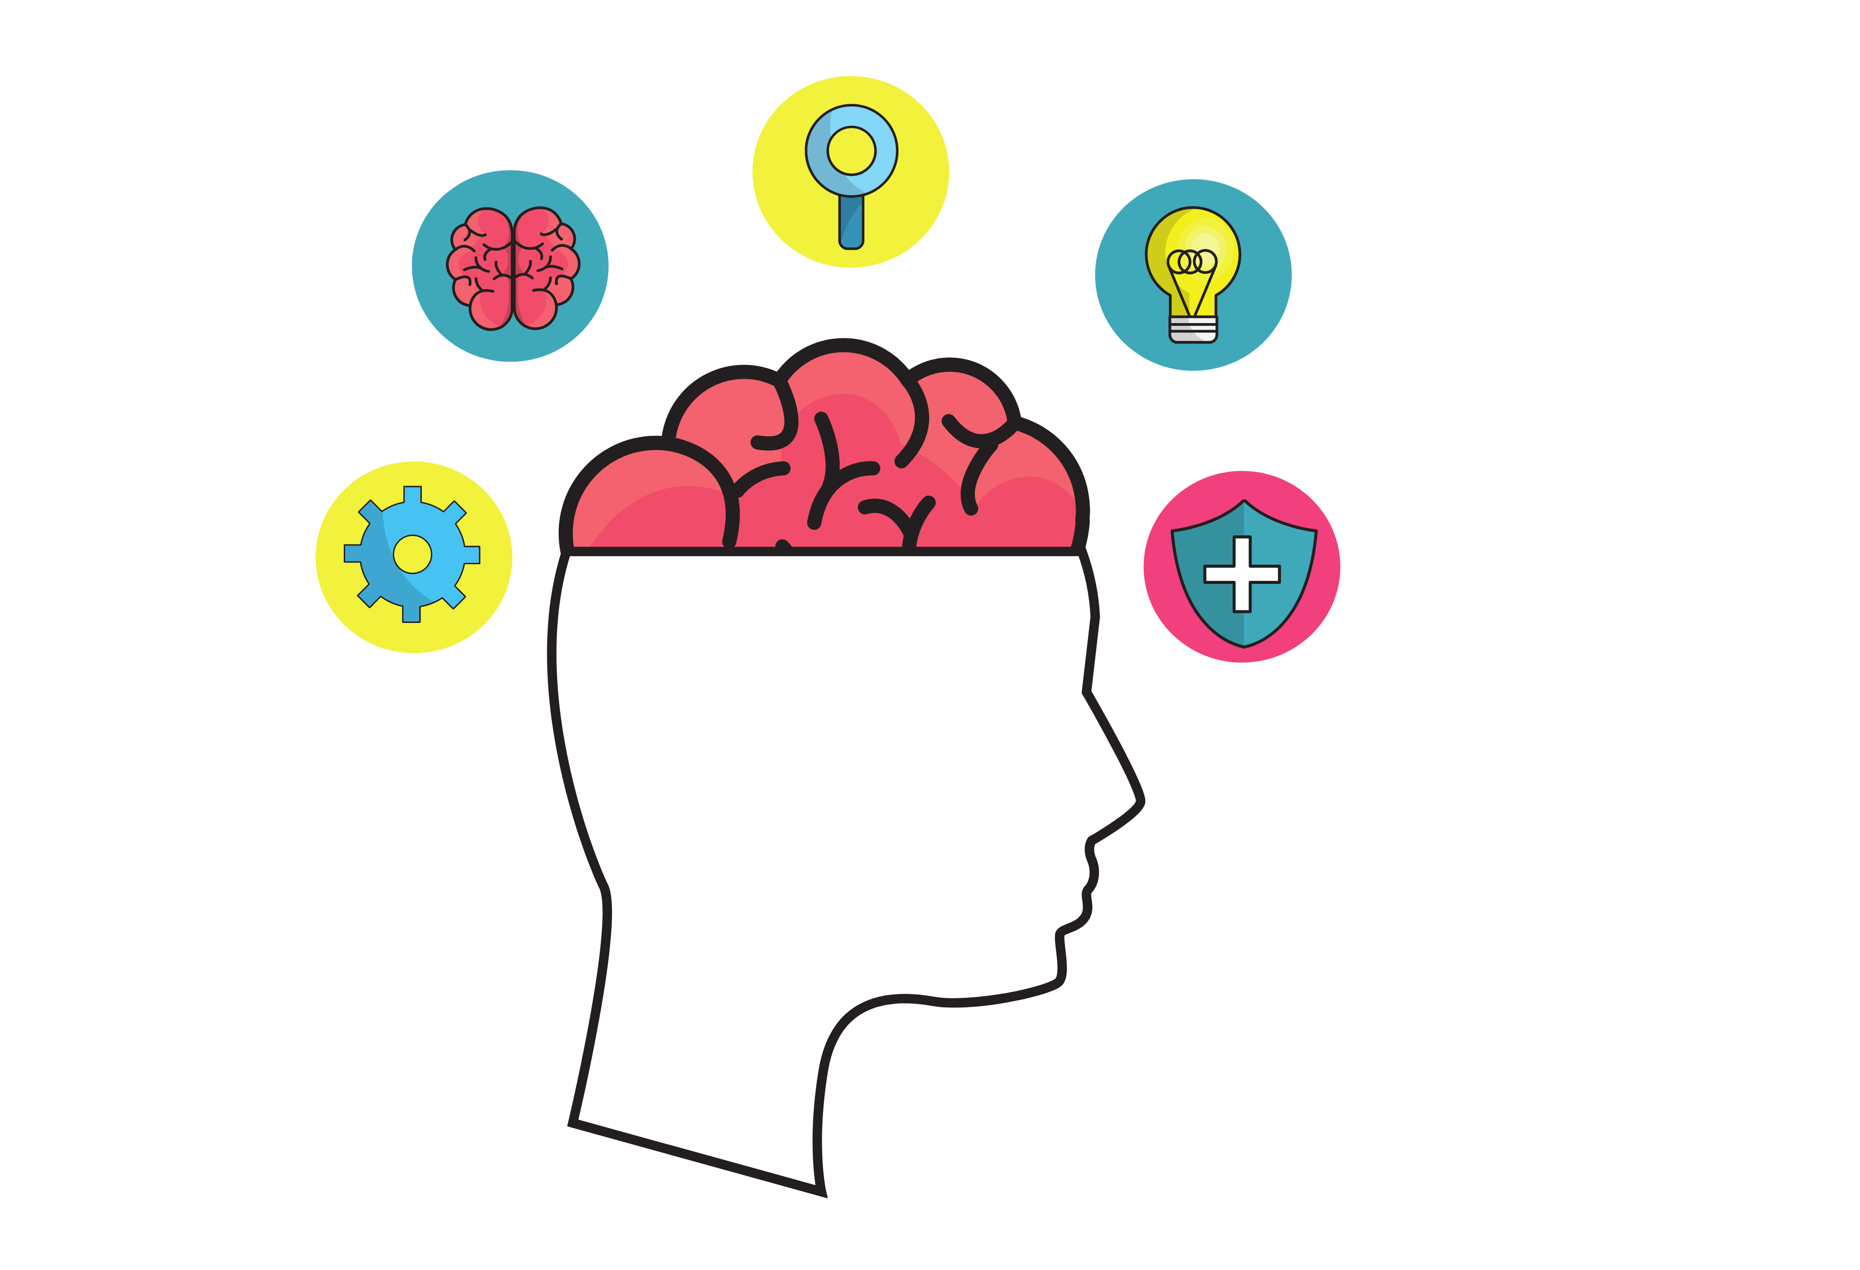
Adolescent Translational Science
Translating neurodevelopmental theory and research to clinical intervention remains challenging.
Basic Neurodevelopmental Science
Clinical Intervention with Adolescents
?
Notes:
However, in many ways, translating the normative neurodevelopmental theory and the relative new field of adolescent brain development by way of noninvasive human neuroimaging and brain-behavior research to substnative clinical application and intervention with adolescents in psychiatric care remains very very challenge.
That is recognizing the real translational gap that exists linking the types of more mechanistic research we may do in the lab to the work we do in the clinic.

Slide 8
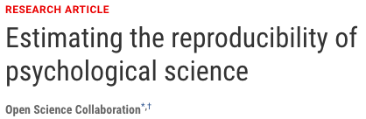
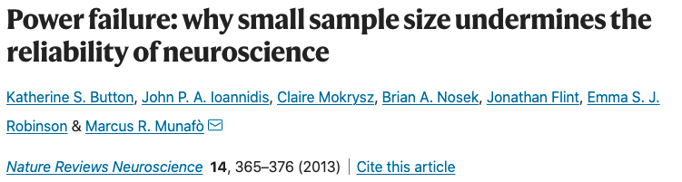

Challenges to Reproducibility
Increasing concerns in psychology and neuroscience on the reproducibility of findings further limits clinical translation.
Clinical Intervention with Adolescents
?
Notes:
Within this context, we might also acknowledge the broader challenges to the reproducibility of neuroscience studies more generally, that I would suggest further highlights this translation gap in my area.
For example, considering some of the noted challenges from large-scale reproducibility investigations, highlighted by the titles shown here.
And one of the ways that I think this in my own work, is that a necessary first step towards clinical utility is of course, research utility and reproducibility.
Something can not really be thought to be useful in clinical care, until we can really reliably use it in the lab.

Slide 9
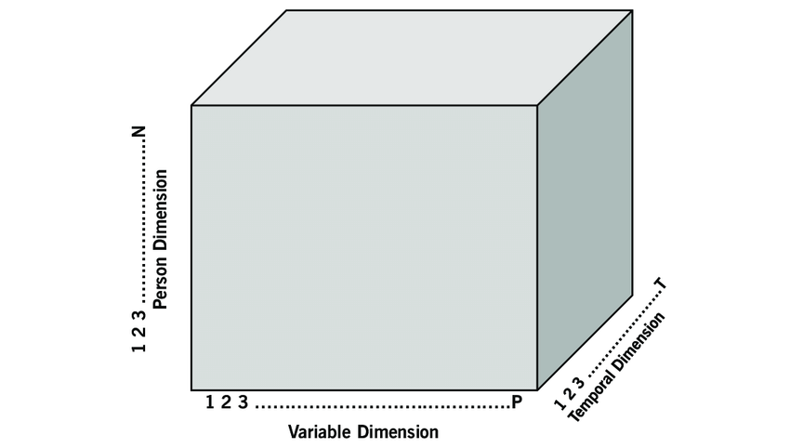

Leveraging Big Data in Adolescent Transitional Science
Big Data & Computational Methods
Adolescent Neurodevelopment
# of Participants
N / Sample Size
# of Time Points
# Diff. Measures Collected
Notes:
To this end, a primary focus of our current program of research, and the work I will be be presenting today, utilizes ”big data” and complementary “computational methods” in neurodevelopmental and human clinical neuroscience to work towards closing the gap in translation.

Slide 10
Leveraging Big Data in Adolescent Transitional Science

Slide 11
Lifespan non-linear modeling as insights into development periods
General Additive (Mixed) Models (GAM/GAMMs)¹
Non-linear modeling
Quantitatively defined functional form
Penalized splines
Linear
Poly.
GAM
¹Wood, 2018, MGCV Package
Notes:
One of the ways that we have examined this questions, central to themes of this educational course on normative modeling, is through the use of general additive models and general addivitve mixed models with
This lecture is on applied use case of GAMs but briefly, as shown in the figure below, the advantage of this gamm approach (particularly relative to linear or polynomial regression) is that it can flexibly adapt and provide realistic fits to non-linear shapes, including developmentally-relevant ones, even when the exact functional form may be unknown.
That is that the use of penalized splines we are quantitatively defining the optimal functional form linking independent and dependent variables. This turns out ot be of fantastic use for specific cases of thinking through relative shape and timing of lifespan trajectories for more developmental inferences.

Slide 12
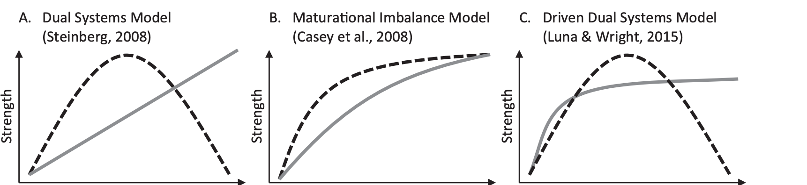
Neurobehavioral Theories of Adolescence
Clarifying neurodevelopmental processes of adolescence is essential for translating this research towards clinical care.
Reward Systems
Cognitive
Systems
Adolescence
Adolescence
Adolescence
Shulman et al. 2016
Notes:
As an example of this, and as some of you may be aware for those of you the know this literature, there is a relative lack of clarity in neurodevelopmental perspectives on the adolescent period with respect to various trajectories of core neurobehavioral systems.
Multiple variations of a generalized or heuristic model of reward and cognitive systems having been suggested.
Here I am highlighting just three of the many many versions that emphasize potential trajectories of these dual systems of reward and cognition.
But really critically, these remain heuristic and theoretical accounts, useful for hypotheses generation, but largely remained untested or rule in or out empirically, which prevents clear clinical implementation or clear support for this broader translational spectrum that is the focus of my work.

Slide 13
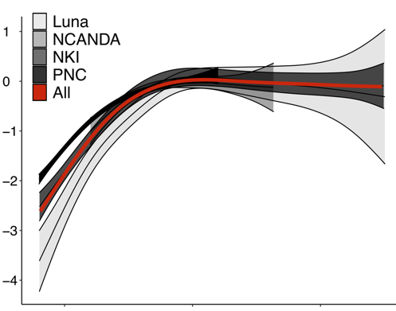
Adolescent Development
Cognition (Executive Function)
(N>10,000; 4 datasets; 17 EF measures)
Executive Function (z-score)
Non-linear trajectories via
general additive [mixed] models
10
20
30
Age (years)
Tervo-Clemmens et al., 2023, Nature Communications
Notes:
So we have had some recent in leveraging big data to clarifying the normative behavioral process of the adolescent period towards translationally relevent insights.
As an example of this, in recent work I led, we amassed the very largest sample of the full adolescent period that examining neuropsychological executive function tasks. Performance-based cognition. This included 4 independent datasets, from data 17 distinct measures across the literature,
This work—driven by big data and reproducibility, or the science of science principles, makes clear the importance of the the potential opening and closing of the adolescent period based on fundamental changes in the rate and timing development in goal-directed cognition, or executive function.

Slide 14
Adolescent Development
Reward (Risk-Taking)
(N>1,000,000; NSDUH 2002-2019)
1
Self-
Reported
“Risk-Taker”
Substance Use Initiation
Risk-Taking (Scaled)
.5
0
30
20
10
Age (years)
Tervo-Clemmens et al., 2024, J. Adolescent Health
Notes:
In analogous recent work I have led we have used large-scale, national survey data to better determine developmental trajectories of REWARD-RELATED behaviors during adolescence by way of different facets of potential risk-taking.
This is data from over 1 Million Participants from the 2002-2019 National Survey on Drug Use and Health (NSDUH)
Shown in the figure on the right, this plots presents population representative and non-linear trajectories of risk-taking metrics as a function of again, age in years and supports the inference of adolescence as the period of the lifespan with potentially the highest reward relatied risk-=taking behaviors.

Slide 15
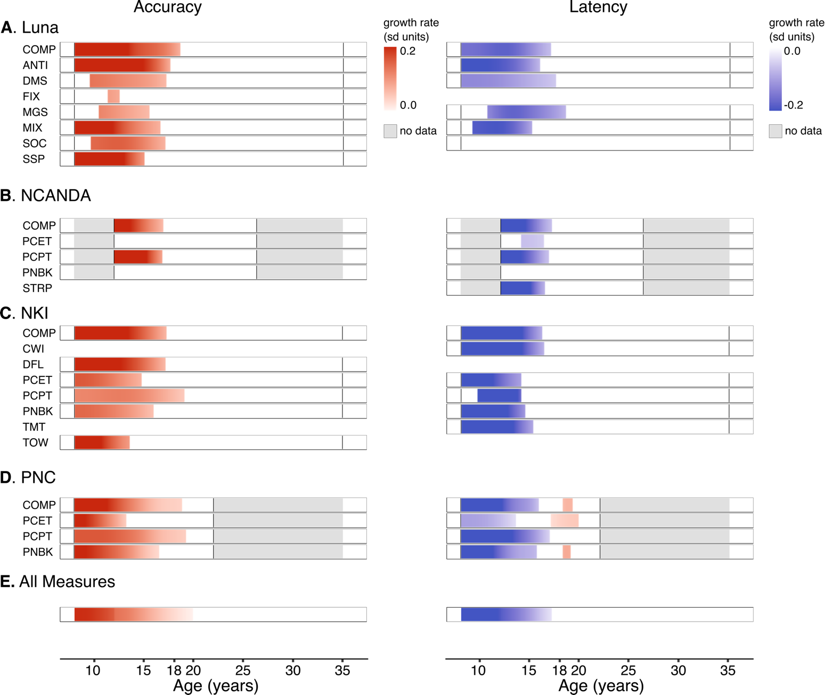

Refined Developmental Model
Cognitive
Systems
Reward Systems
Maturational Timing via Derivatives of Fits
Cognition
Reward
Tervo-Clemmens et al., 2023, 2024
Notes:
One of the things that most exists us is using the large-scale data to really focus in on this key developmental period then of mid-to late-adolescence about 15-20 years old where cognition may be stabilizing towards adult levels but in the context of heightened risk-taking behaviors.
Putting the results of these first two studies together, these processes shown below the line plots by gradient bars emphasizing significant periods of cognitive maturation (the red bar) and peak reward processes (blue bar). These are significant periods of the first and second derivative respectively, for those that may be interested.

Slide 16
Refined Developmental Model
Mental Health/Substance Use Disorder Onset
Paus et al 2008
Adolescent Maturational Timing
Cognition
Reward
Tervo-Clemmens et al., 2023, 2024
Notes:
HOWEVER, despite this normative maturation, for certain adolescents, this balance of reward and cognitive systems, and deviations from this normative development timing, may offer critical insights to the onset of mental health and substance use disorders that so often first emerge during this period
Shown here, aligning with respect to age, the previous figure of diagnostic onsets to the unfolding and maturational timing of these cognitive (shown in red) and reward (shown in blue) processes.

Slide 17
Outline
Conceptual and methodological context for these questions.
Theories of human neurobehavioral development in adolescence
Non-linear modeling of lifespan trajectories
Foundational methods we have used to construct models across assessments and datasets.
R markdown and interactive examples
Extensions of these methods and looking forward to new directions.

Slide 18
Challenges to Reproducibility
Increasing concerns in psychology and neuroscience on the reproducibility of findings further limits clinical translation.
Clinical Intervention with Adolescents
?

Slide 19
Multi-assessment & Multi-dataset approach
Building generalizability and reproducibility into studies.
Investigations with relatively small datasets or narrow subsets of measures have identified general executive function development, but the specific maturational timing remains unknown.
It is unclear how these processes unfold, or their developmental similarity, among potential subprocesses indexed by the dozens of laboratory-based and neuropsychological executive function measures used in the broader literature.

Slide 20
Outline
Conceptual and methodological context for these questions.
Theories of human neurobehavioral development in adolescence
Non-linear modeling of lifespan trajectories
Foundational methods we have used to construct models across assessments and datasets.
R markdown and interactive examples
Extensions of these methods and looking forward to new directions.

Slide 21
Outline
Conceptual and methodological context for these questions.
Theories of human neurobehavioral development in adolescence
Non-linear modeling of lifespan trajectories
Foundational methods we have used to construct models across assessments and datasets.
R markdown and interactive examples
Extensions of these methods and looking forward to new directions.

Slide 22
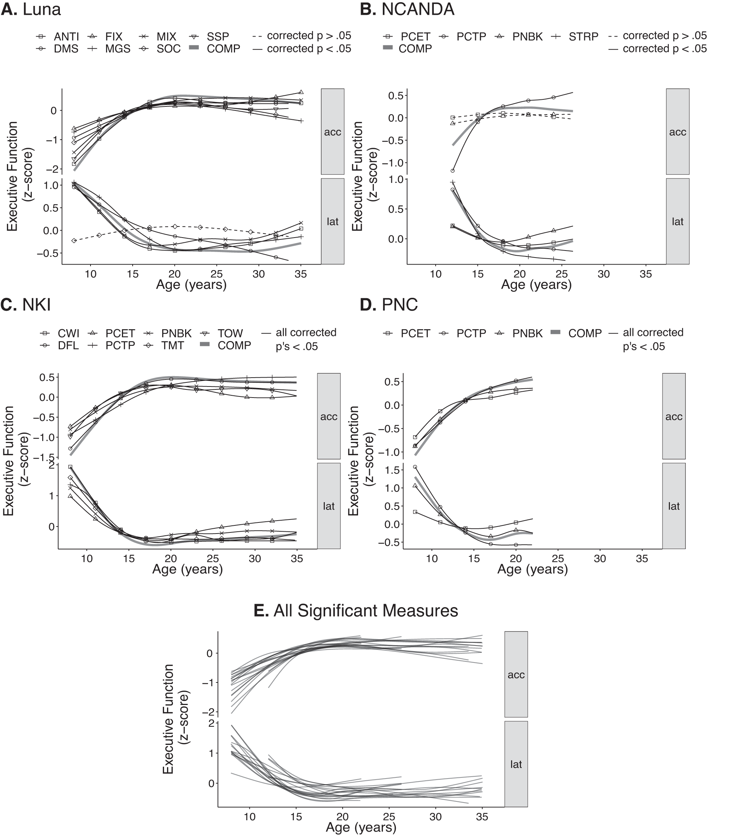
Review and extension of the “real” data
Four independent, publicly available adolescent to young adulthood datasets (Luna Cohort, NCANDA, NKI, PNC ), total N = 10,766. Nearly all measures have corrected, age-related change.
Tervo-Clemmens et al., 2023, Nature Communications

Slide 23
A Canonical Trajectory of EF Development
A common shape emerges clearly when we stack all significant measures on top of each other.

Slide 24
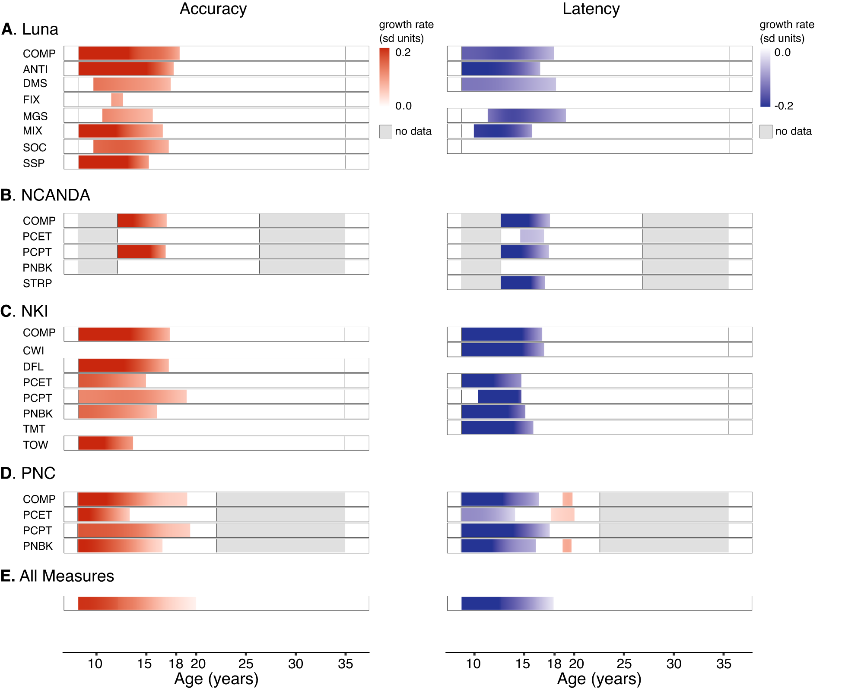
Consistency in timing via derivative testing
Testing of local age-related changes likewise supports developmental consistency across EF assessments.

Slide 25
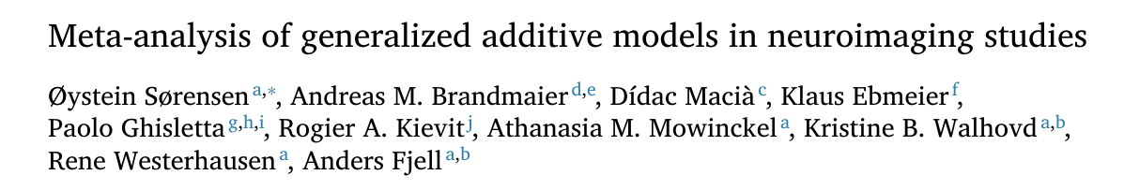
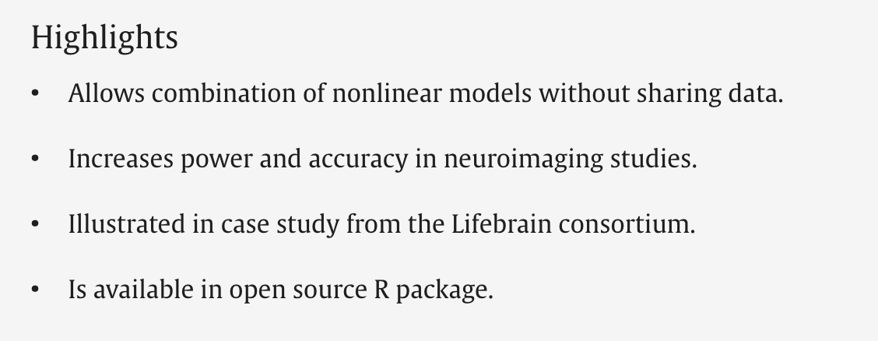
Further Extensions: Aggregate inference
Point-wise meta-analysis of generalized additive models (as in Sørensen et al., 2021 NeuroImage).

Slide 26
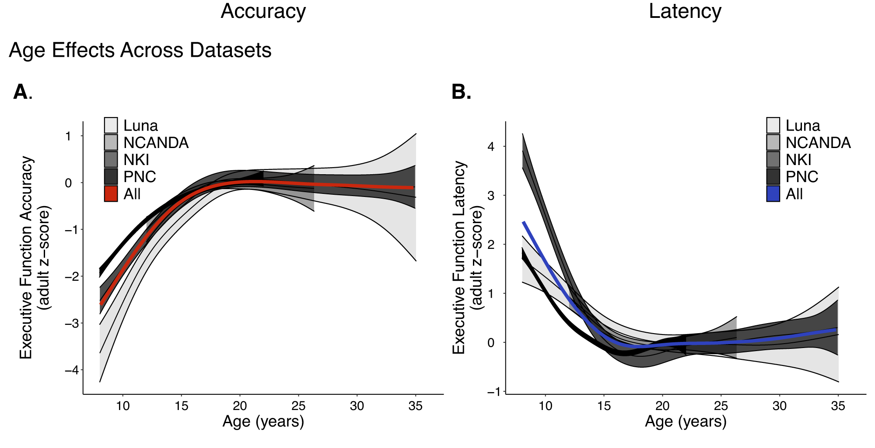
Further Extensions: Aggregate inference
Tervo-Clemmens et al., 2023, Nature Communications

Slide 27
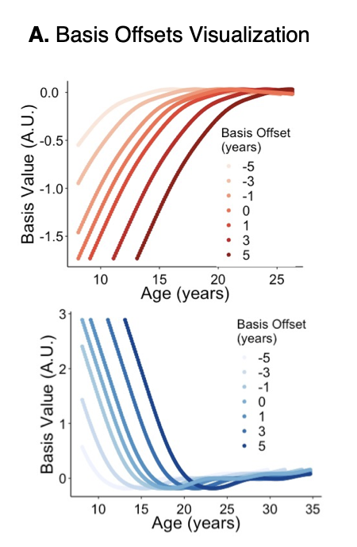
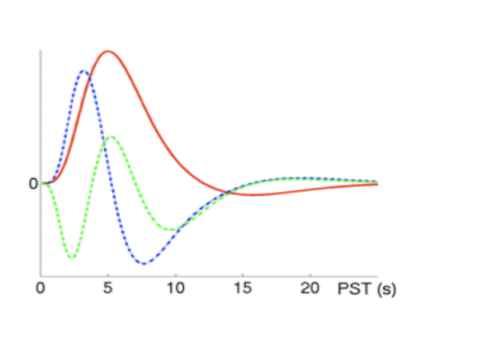
Further Extensions: Basis Functions
basis functions for task-based fMRI GLM
EF trajectory basis functions
Tervo-Clemmens et al., 2023, Nature Communications

Slide 28
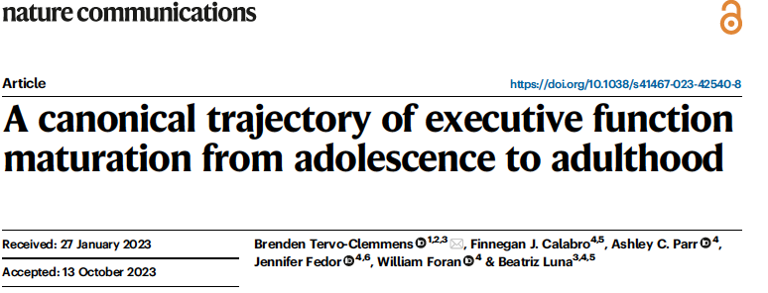
Further Extensions

Slide 29


Acknowledgements
The Tervo-Clemmens (T-C) Lab
The Masonic Institute for the Developing Brain
External Collaborators
Scott Marek, PhD, Washington University in St. Louis
Nico Dosenbach, MD, PhD, Washington University in St. Louis
Deanna Barch, PhD, Washington University in St. Louis
Wes Thompson, PhD, Laureate Institute for Brain Research
Henning Tiemeier, MD, PhD, Harvard
Leah Sommerville, PhD, Harvard
Beatriz Luna, PhD, University of Pittsburgh
Ashley Parr, PhD, University of Pittsburgh
Finnegan Calabro, PhD, University of Pittsburgh
Participants and their families!
Support
Notes:
With that I want to just conclude by acknowledging my lab as well as all of my new colleagues at the broader MIDB
key external collaborators without whom this work would not be possible,
My Funding sources.
and of course, the participants and their families who take time and effort out of their day to provide us these data.

Slide 30
Modeling Adolescent `Executive Function Development Across Assessments and Datasets
Brenden Tervo-Clemmens, PhD
University of Minnesota
btervocl@umn.edu
@tervoclemmensb

